Slide 1
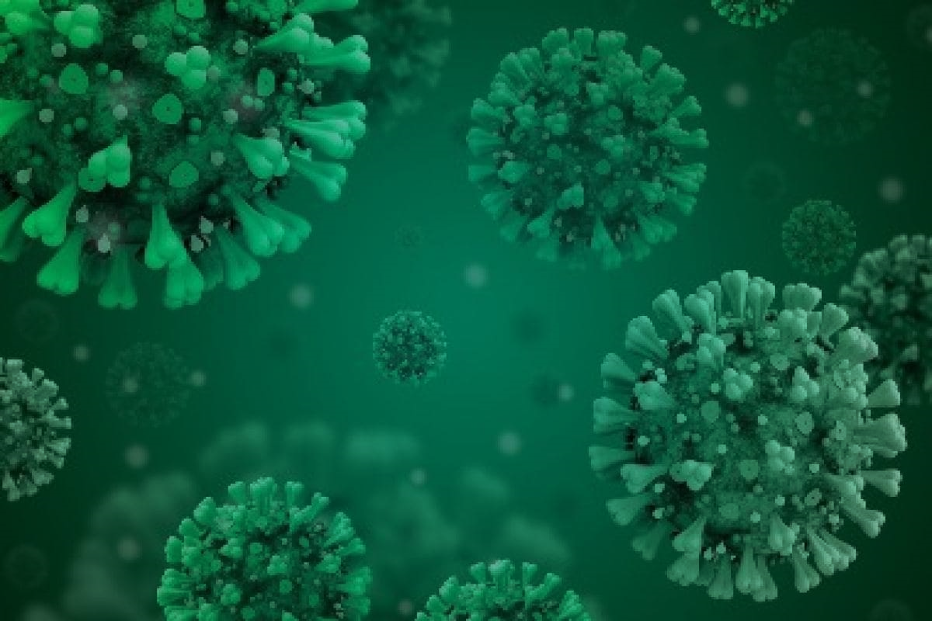


Development and Proof-of-Concept
Implementation of the South Florida Miami RADx-rad
SARS-CoV-2 Wastewater-Based Surveillance Infrastructure
SF-RAD:
Presented by:
Helena Solo-Gabriele, PhD
University of Miami
Funded by
NIH RADx-rad Grant
1U01DA053941-01

Slide 2
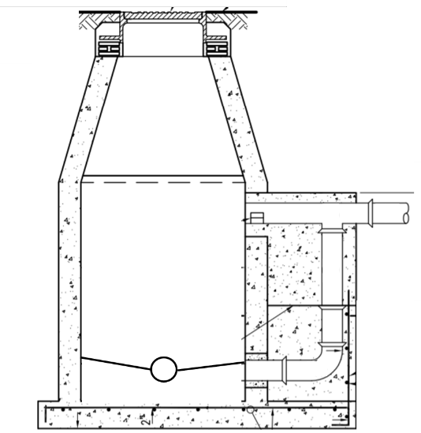
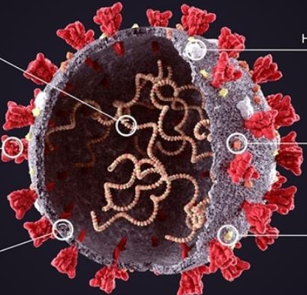
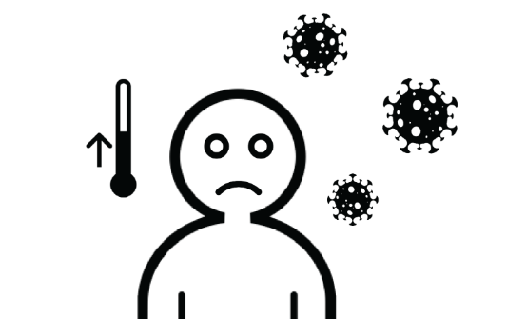
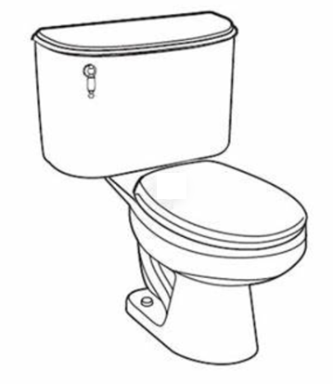


Motivation & Objectives
Infected humans excrete COVID-19 virus in feces and urine
RNA
2 L
Sample Bottle
SARS-CoV-2
Sanitary Sewer
Ultimate objective: Relate wastewater measurements to predict COVID-19 cases.

Slide 3
SF-RAD: SARS-CoV-2 Wastewater-Based Surveillance
Aims
Data standardization and informatics infrastructure
Wastewater characterization
Integration with human health surveillance
HPCPS
Human
Surveillance
Outbreak
Characterization
and Prediction
Policy Decisions
Data
Integration
Wastewater
Surveillance
Aim 1
Aim 3
Aim 2

Slide 4
SF-RAD: SARS-CoV-2 Wastewater-Based Surveillance
Administrative Organization and Leadership
RADx Data Coodination Center (DCC)
(a) Admin Operations, (b) Data Collection / Integration / Sharing, (c) Data Management / Use
SF-RAD Administrative Leads
Helena Solo-Gabriele (UM, PI), George Grills (UM, co-I), Stephan Schürer (UM, PI), Chris Mason (WCM, PI)
Aim 1: Data
Standardization
Stephan Schürer (UM),
Dusica Vidovic (UM)
Aim 2: Wastewater Characterization
Helena Solo-Gabriele (UM),
Chris Mason (WCM)
Aim 3: Integration with Human Health Surveillance
Chris Mason (WCM),
Naresh Kumar (UM)
Human Population and Clinical Patient Surveillance
Erin Kobetz (UM), Natasha Solle (UM), Bhavarth Shukla (UM)

Slide 5
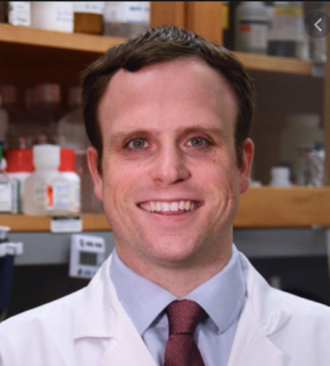
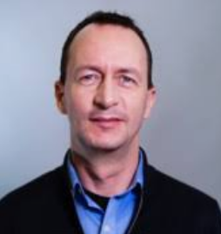
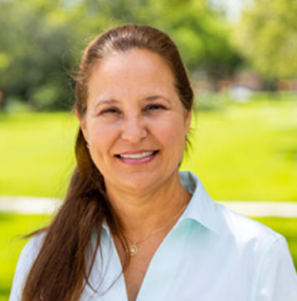
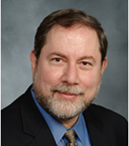
SF-RAD: SARS-CoV-2 Wastewater-Based Surveillance
Project Leaders
Chris
Stephan
Helena
George
PIs: Chris Mason, Stephan Schürer, Helena Solo-Gabriele*
Administrative Core: George Grills (co-I)
Administrative Support: Maria Robertson

Slide 6
Aim 2:
Wastewater Characterization

Slide 7
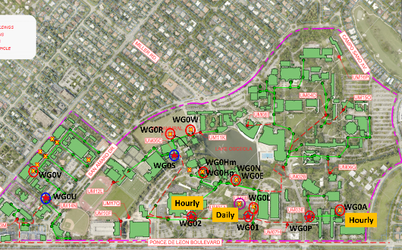
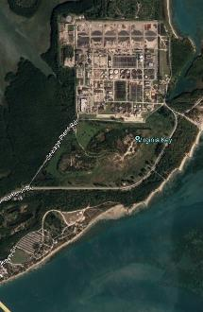
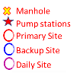
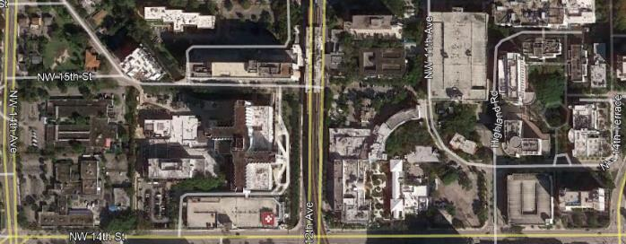
Human Surveillance
Sample Collection Plans
Student Residents
Gables Academic Campus
WWTP
Fall’20/Spring’21
Students tested weekly (nasal swab, qPCR) Supplemented by breath test
COVID results and total tests by building/dorm room
Summer/Fall’21
Unvaccinated students tested weekly
All students tested when wastewater exceeds
WC0D
WR03
University Hospital
Marine Campus
Treat known COVID patients
Electronic medical records pulled regularly
Medical Campus
Miami-Dade County Residents (FDOH)
WM08
WM05
Positives by zip code
Number of tests by zip code
Hospital
WM06

Slide 8
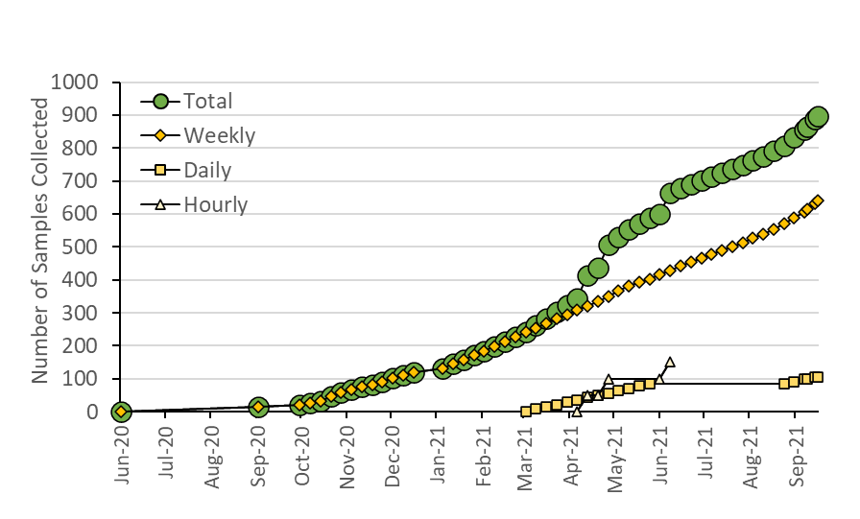
Sample Collection
(Continuing as planned, dorms now 2x per week)
2x
(Sampling Target Achieved)
Daily – Community Scale
Lessons Learned Paper
(4-day warning)
Hourly
Daily –
Building Scale

Slide 9
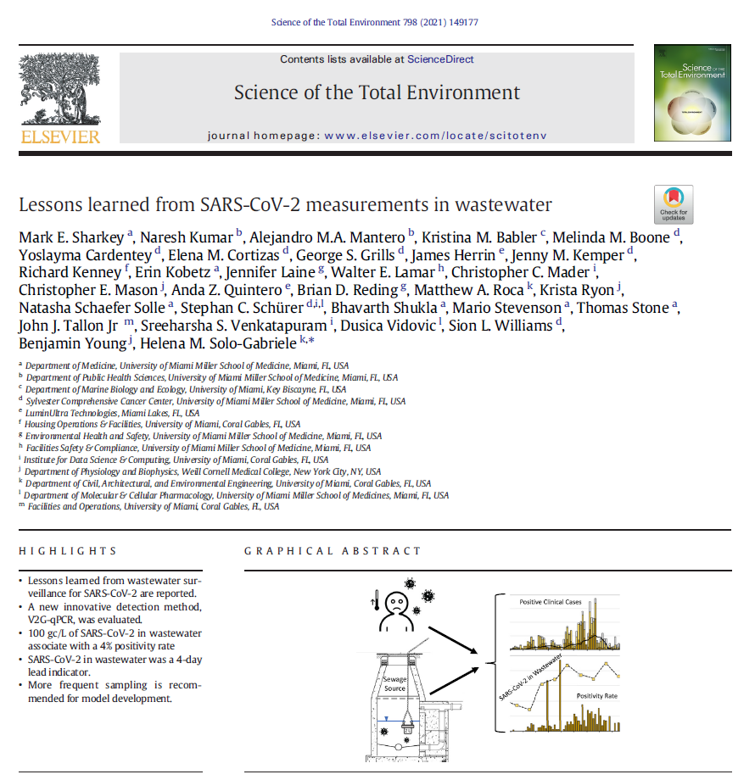
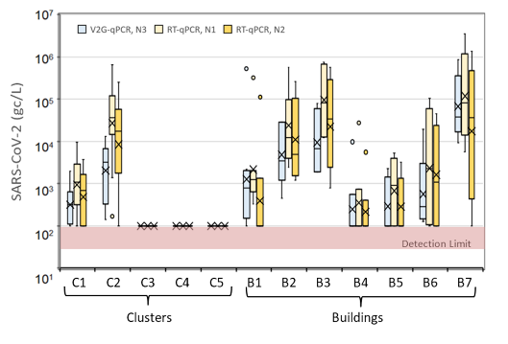
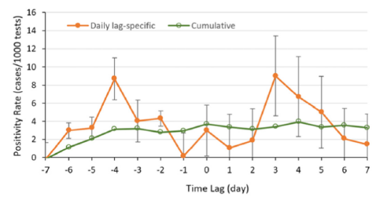
V2G – qPCR works and efficient
A new innovative detection method (V2G-qPCR) was successful
SARS-CoV-2 in wastewater was a 4-day lead indicator
Positivity (%) = 9 ln(C) / 10
  10² gc/L of SARS-CoV-2 in wastewater associated with 4% positivity.
  10⁴ gc/L→ 8%
  10⁶ gc/L→ 12%
4 day fore-warning

Slide 10


SAMPLING at UMiami
Ambient:
Date/time, GPS, T_{air}, Humidity
Collect Samples Weekly
Results available in 12 hours
T, pH, Salinity/SPC, DO, turbidity
0.5L
Sewage
Source
2 L
Univ. Miami Lab
1 L
Sewage
Surface
Sampling Sites (Currently at 18 per day)
13 samples at Gables campus (undergraduate dorms)
1 at Marine campus
2 at University of Miami hospital
2 at the County Central District Wastewater Treatment Plant
2 L

Slide 11
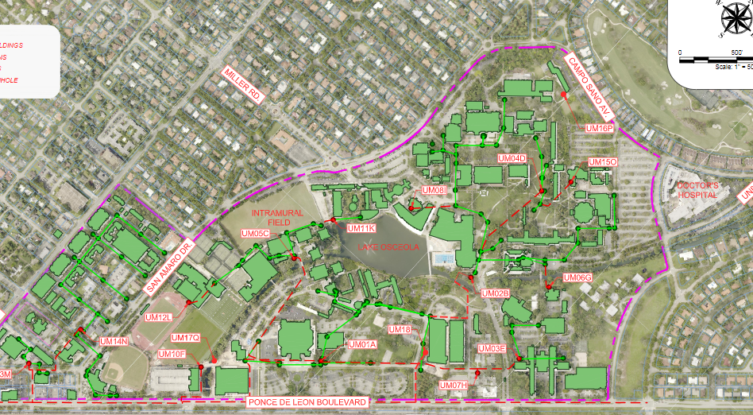
Sanitary Sewer System
Manhole covers
WG0W
WG0R
WG0S
WG0Hm
WG0Hp
WG0V
WG0N
WG0E
WG0U
WG0L
WG0K
WG0A
WG02
WG01
WG0P

Slide 12
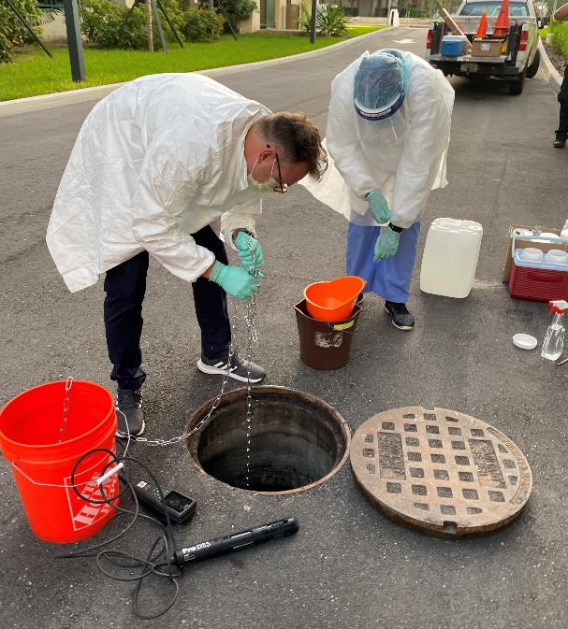
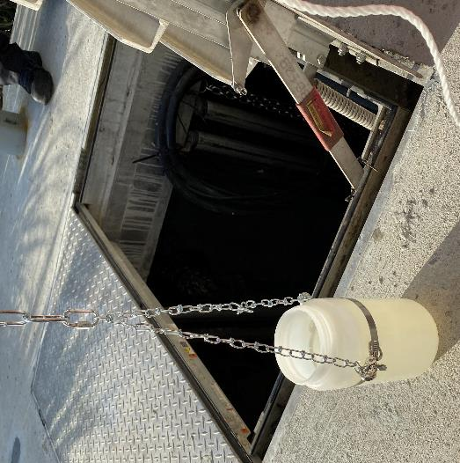
Sampling
Bottle on Chain
3 Containers in Bucket

Slide 13
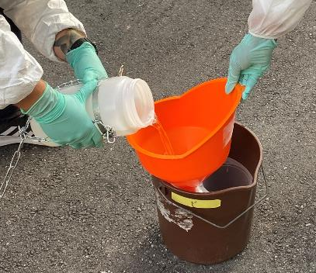
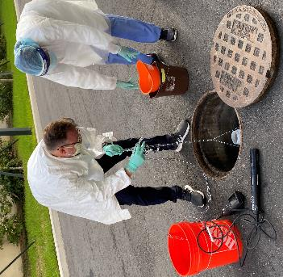
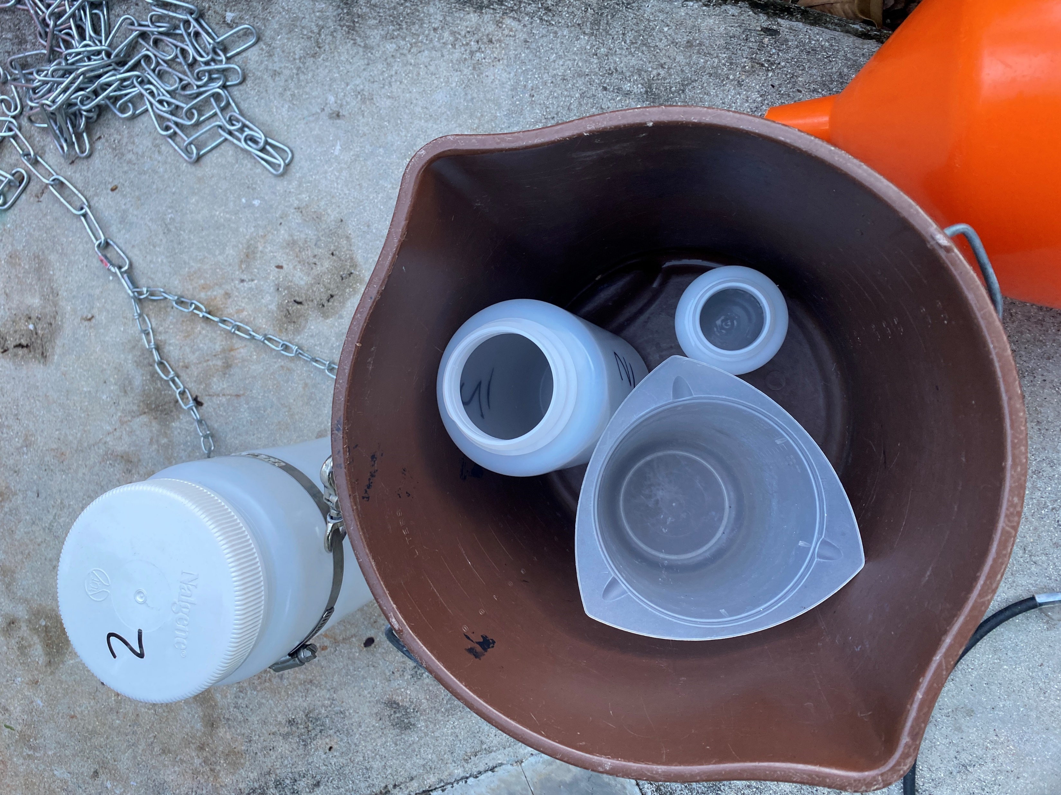
0.5 L
2 L
2 L
1 L
T, pH, SPC, DO, turb.
T, pH, Salinity/SPC, DO, turbidity
0.5L
Commercial Lab
0.5L
Univ. Miami Lab
Fecal Indicator bacteria
2 L
1 L
2 UMiami Labs
1 Lab at WCM
Virus concentration

Slide 14
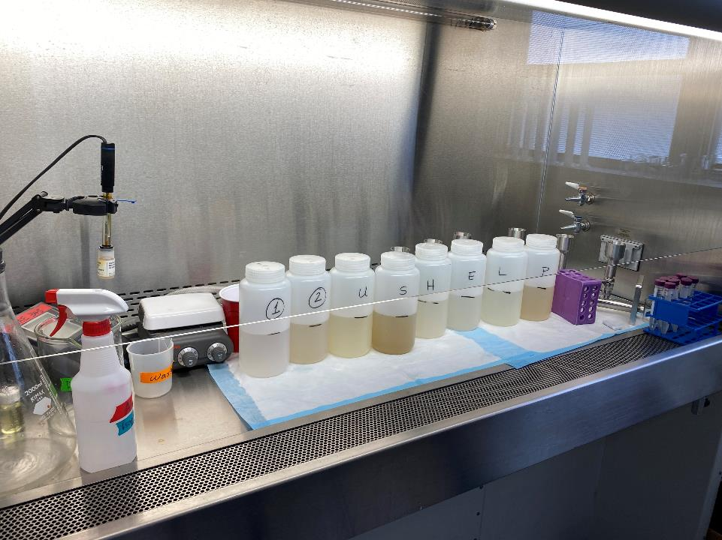
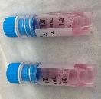
1. Add OC43 spike, recovery control
2. Add MgCl₂ (50 mM)
3. Acidify to pH 3.5-4.5
pH meter
Continuous
Stirring

Slide 15
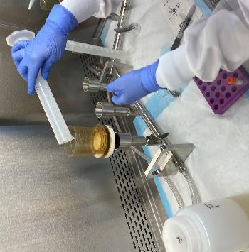
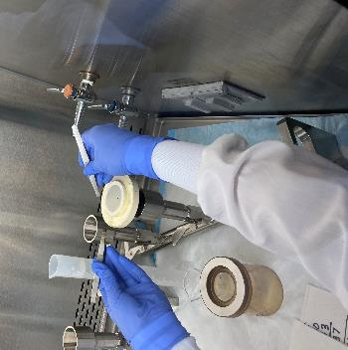
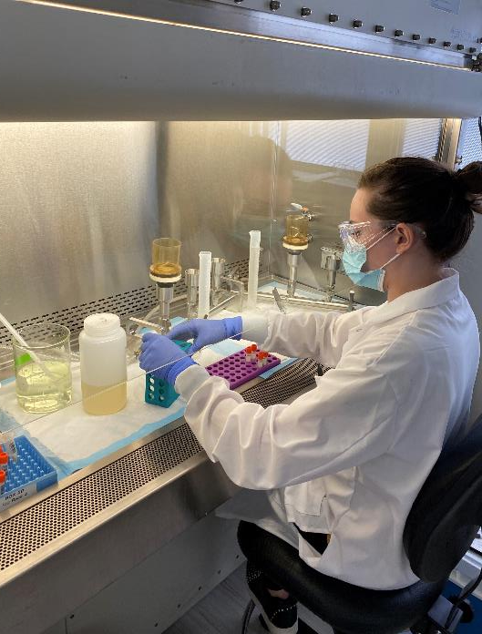
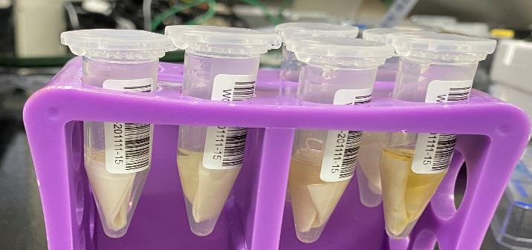
Electronegative
Filter
Folded Filter
In 1.5 ml DNA/RNA
Shield

Slide 16
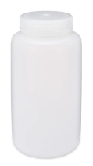

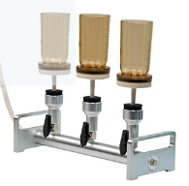

Sample Analysis Plan (Weekly Sampling)
Rapid Detection
Concentration by
Electronegative
Filtration
TINY-LAMP
LAMP
V2G-qPCR
RT-qPCR
Raw
Waste
water
OC43
MgCl₂
Acidify
Williams/Mason
Mason
Sharkey
2x per week
Williams
Genomic Analysis
Williams
Mason
Concentration by Mag Beads
Fecal coliforms
Deep Targeted Sequencing
RNA-seq/
Direct RNA seq
M. Sharkey,
Center for AIDS Research, UM
Metagenomics
Epitranscriptomics
S. Williams
Onco-Genomics Shared Resource, UM
Bioinformatics
C. Mason,
Integrated Genomics Lab, WCM/MetaSub
Strain Identification
(Confirm across both labs)

Slide 17
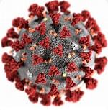
SARS-CoV-2 Results

Slide 18
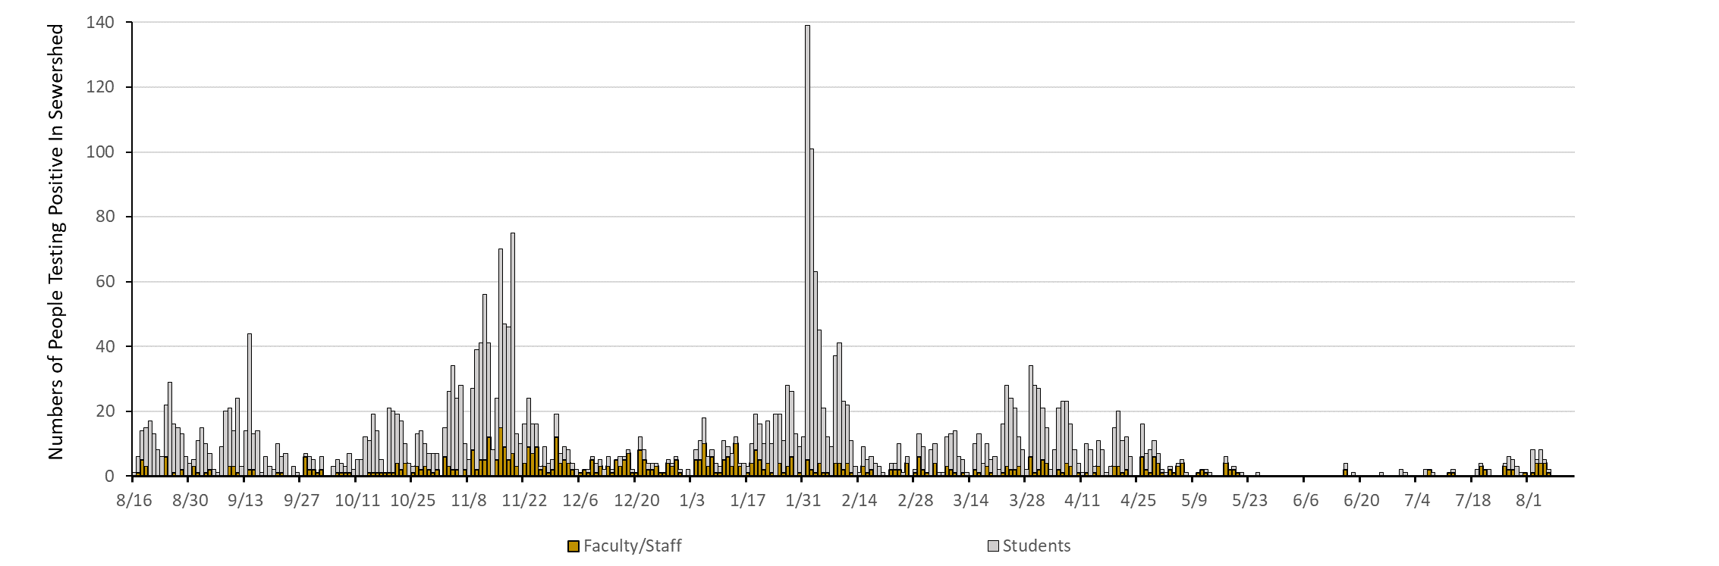
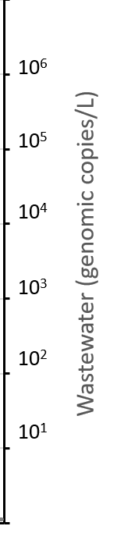
University Surveillance
Detection LImit for WW

Slide 19
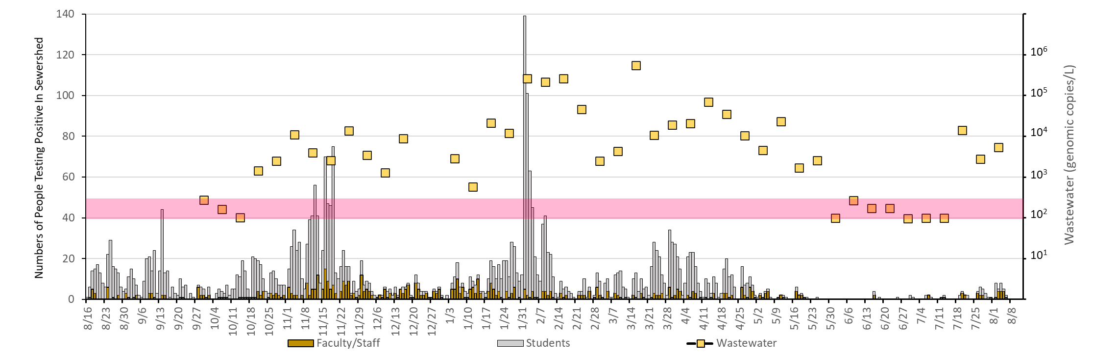
University Surveillance
Wastewater

Slide 20
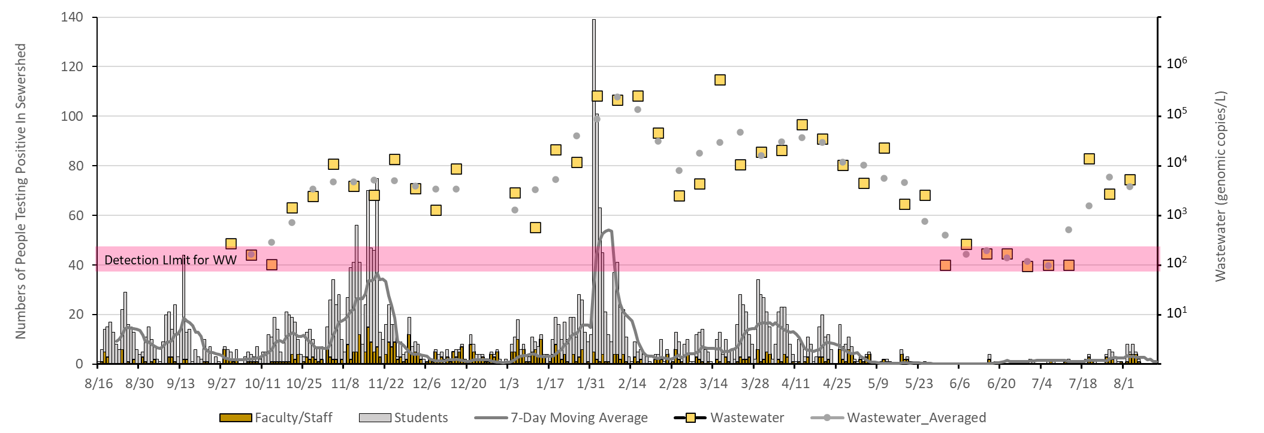
University Surveillance
Wastewater
Moving Average
Human Cases
Vaccine Opt In
For Students

Slide 21
Log-log association between SARS-Cov-2
and new COVID-19 cases shows that
a 1% increase in SARS-CoV-2 was associated
with 0.69% increase in COVID-19 new cases,
June 2020 to May 2021
Coefficient = 0.69, 95% CI = 0.53 - 0.85; p < 0.01)
County Scale
(Miami-Dade County, FL)
Association between SARS-Cov-2
and new COVID-19 cases in Miami-Dade
Association between observed and predicted
new COVID-19 cases in Miami-Dade
Predicted COVID-19 cases
SARS-CoV-2
COVID-19 cases
Observed COVID-19 cases

Slide 22
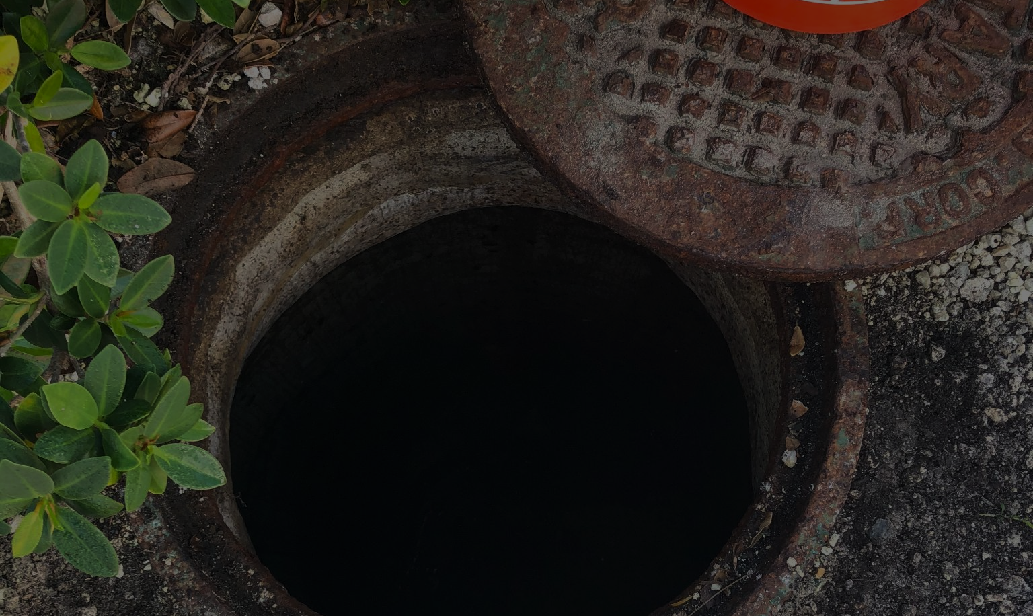
Aim 2, Wastewater Characterization:
Evaluate Sample Concentration Methods
Evaluate Sample Collection Methods (grab vs composite).
Evaluate influence of watershed scale.

Slide 23
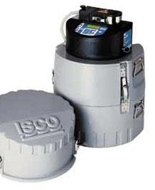
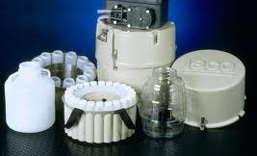
Sample Collection Methods
Grab = Instant in time and space
(fresh sample)
Composite = Samples collected over time at one location (sample sits)

Slide 24
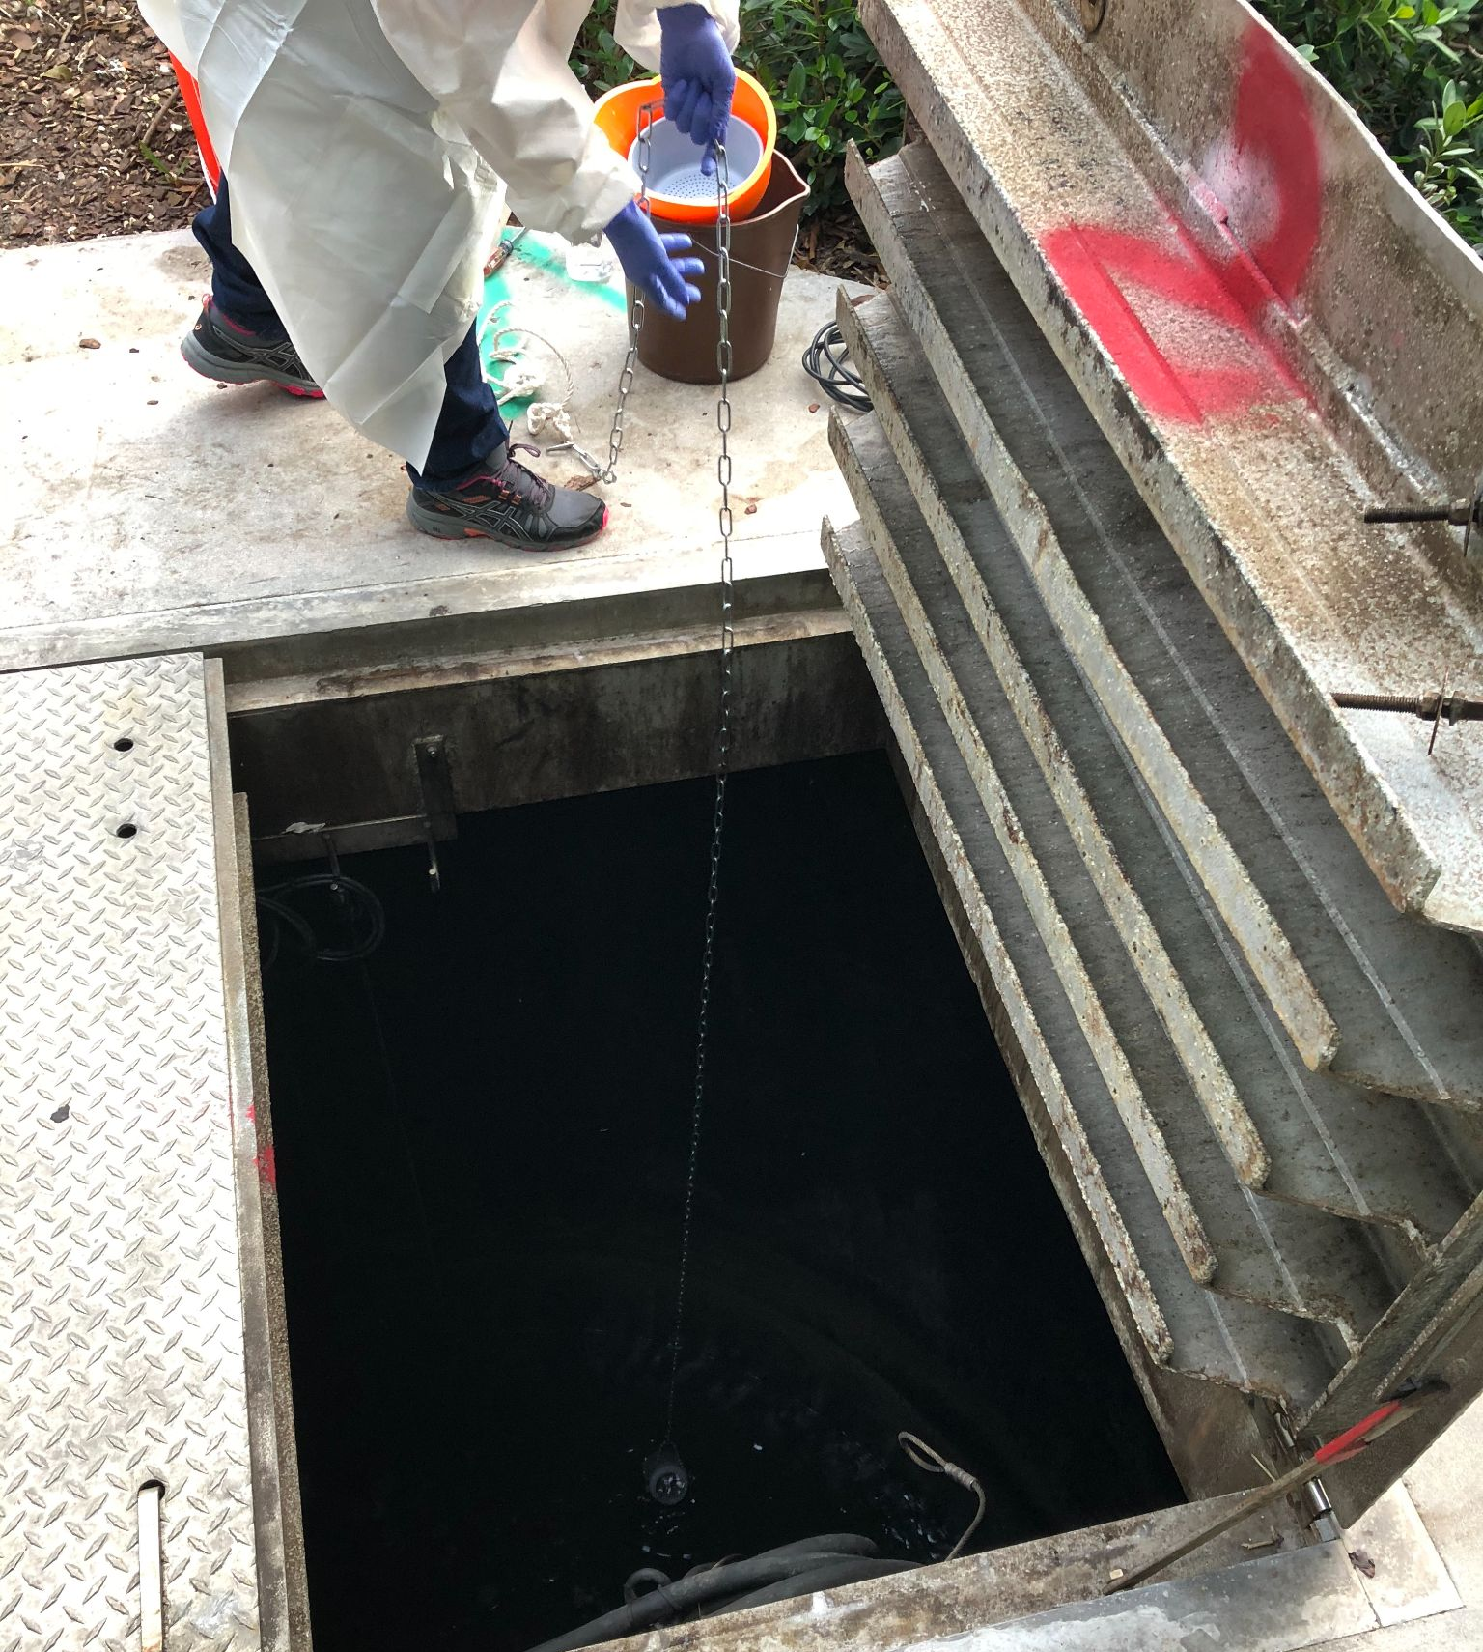
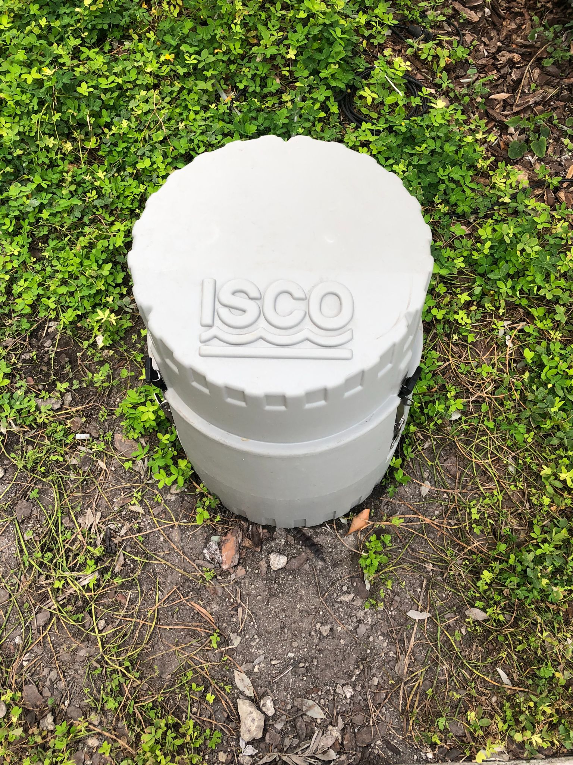
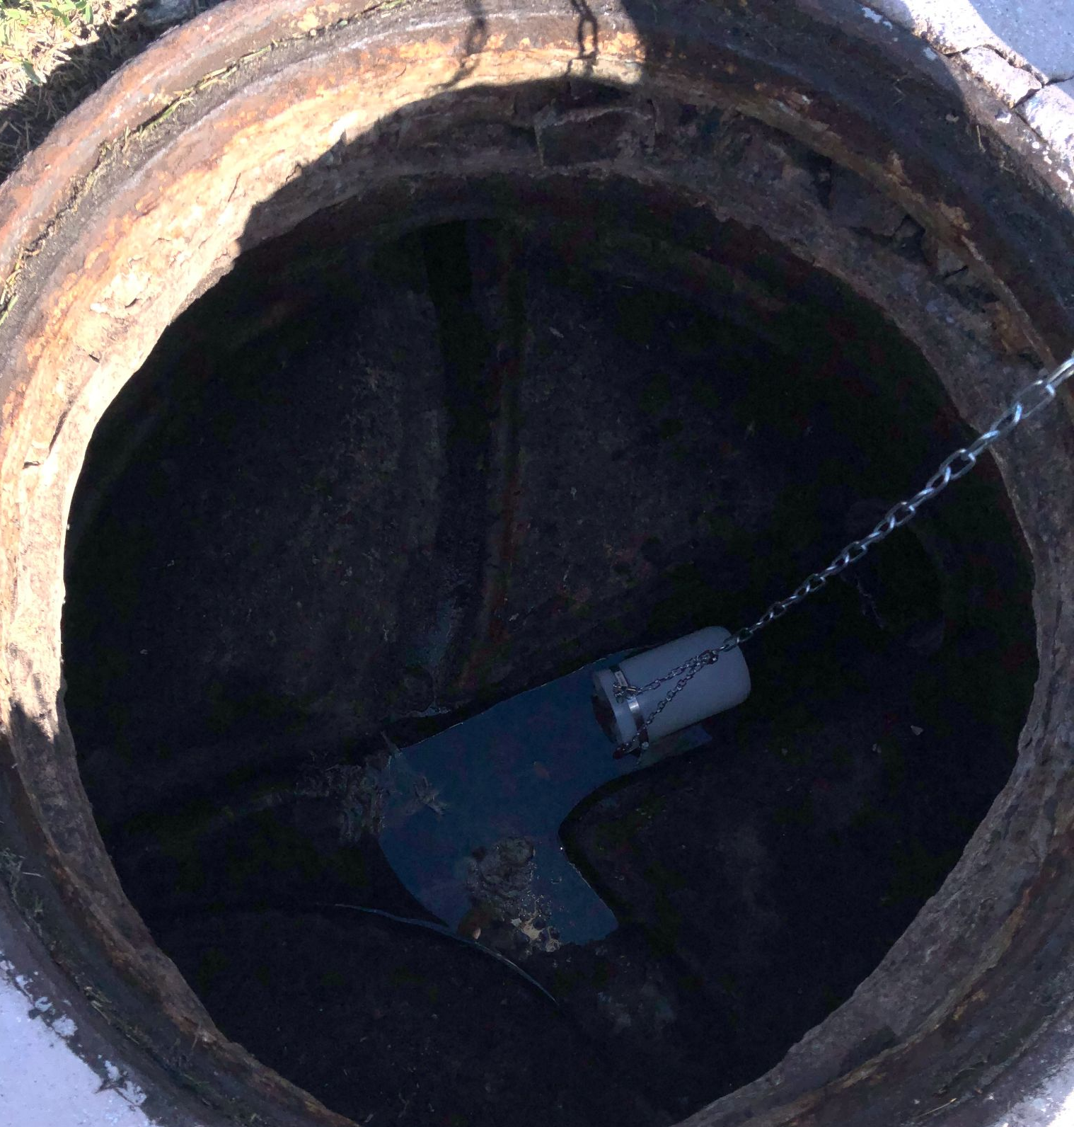
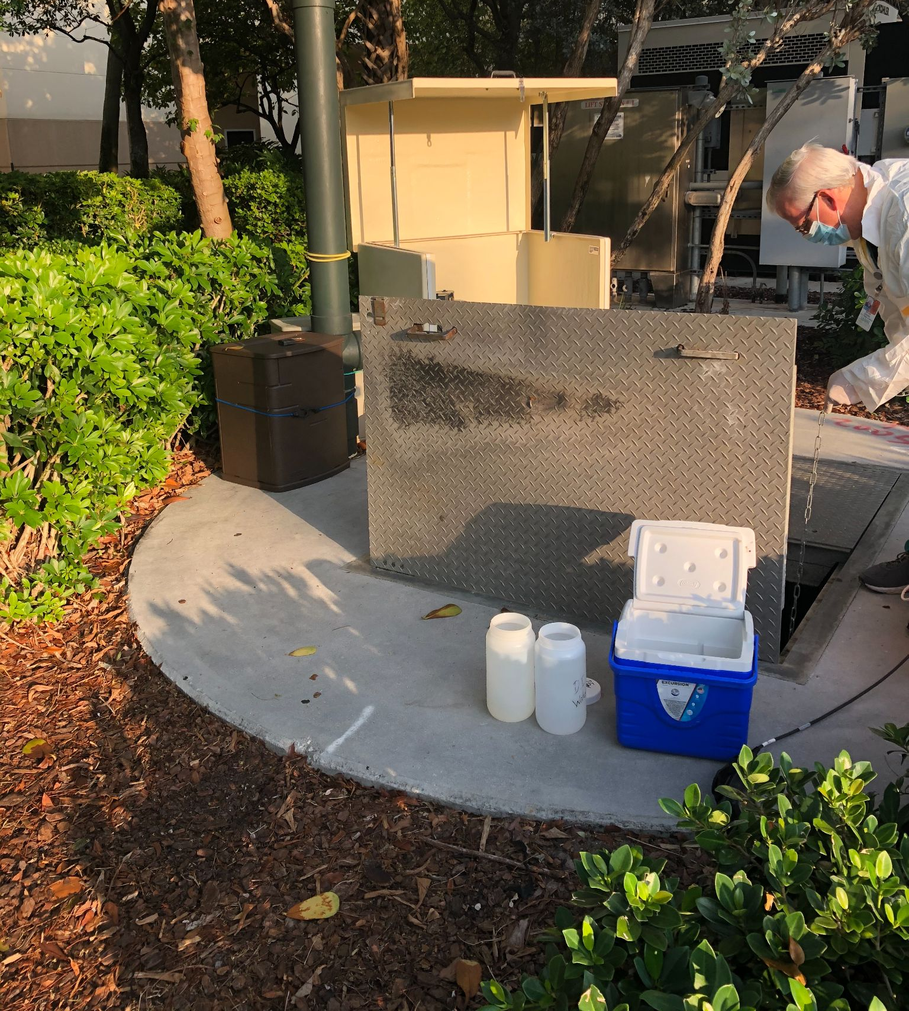
Wastewater Sampling
Where do we sample wastewater from?
  Manholes (building scale)
  Pump Stations (cluster)
  Wastewater Treatment Plant
How do we collect the wastewater?
  Chain and bottle (grab)
  Automatic sampler (composite)
    Samples on each hour, the entire day- 24 hours

Slide 25
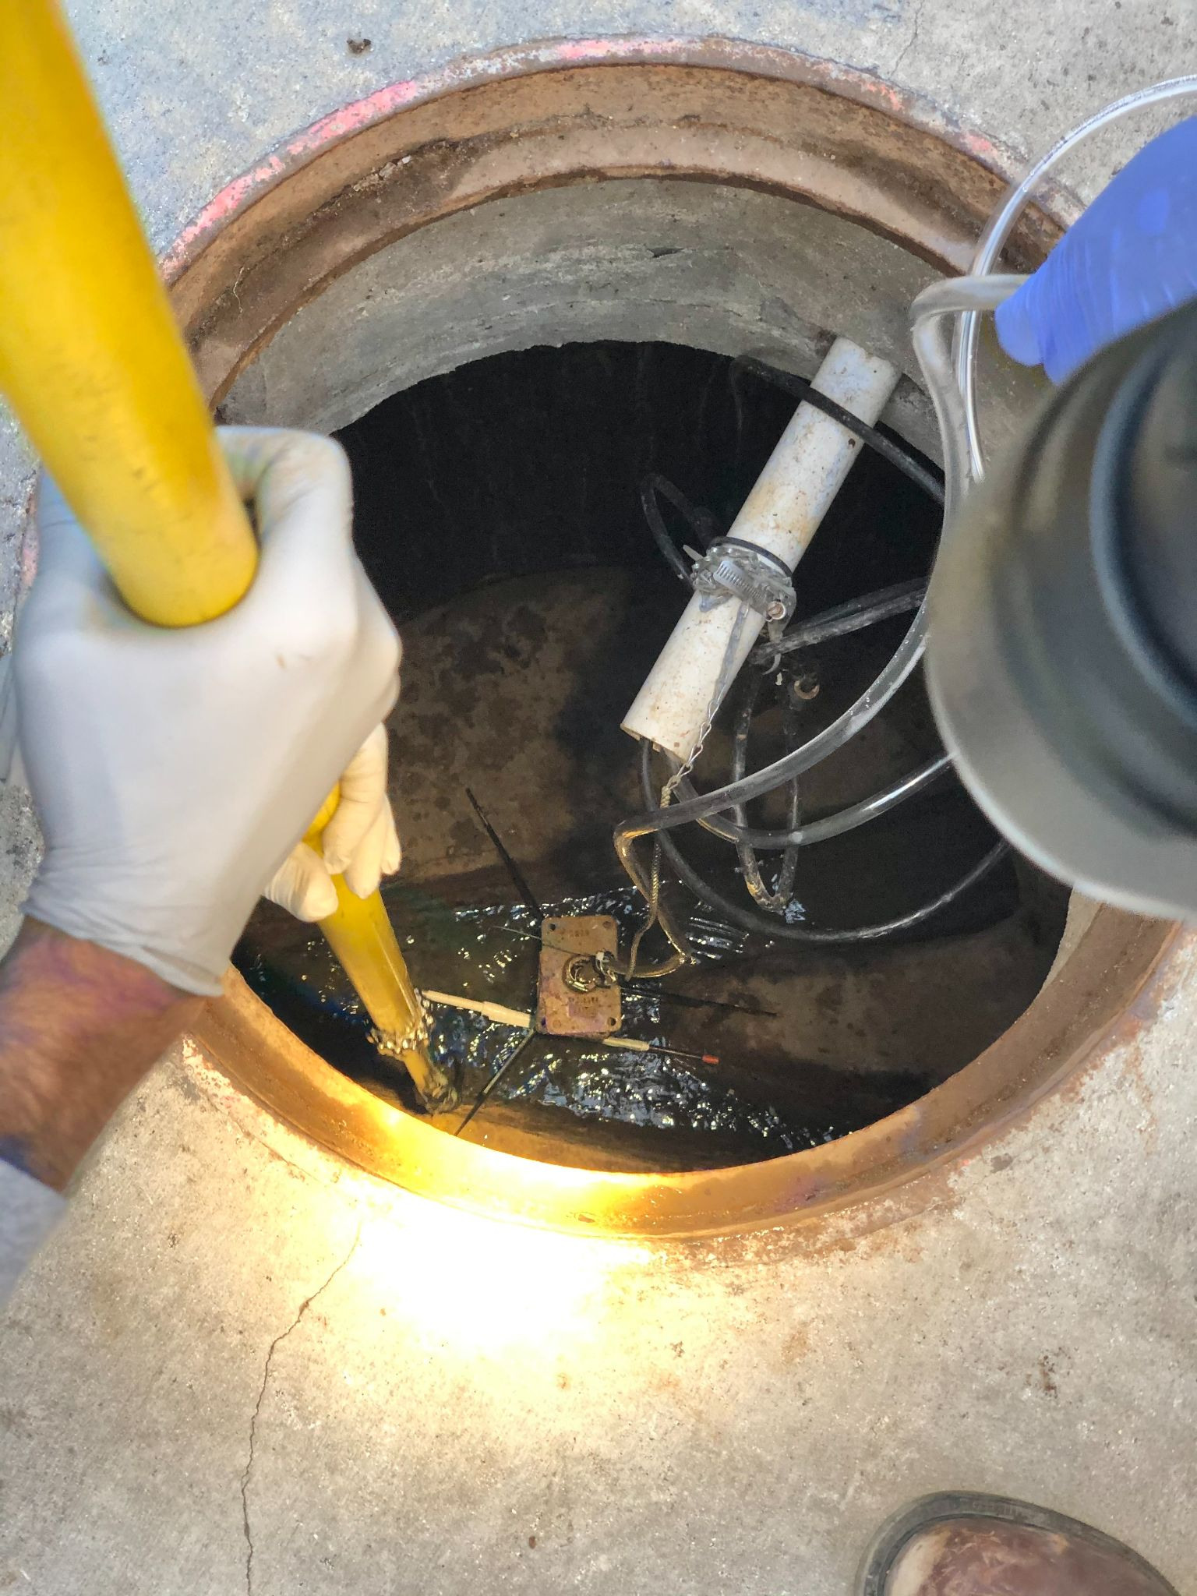
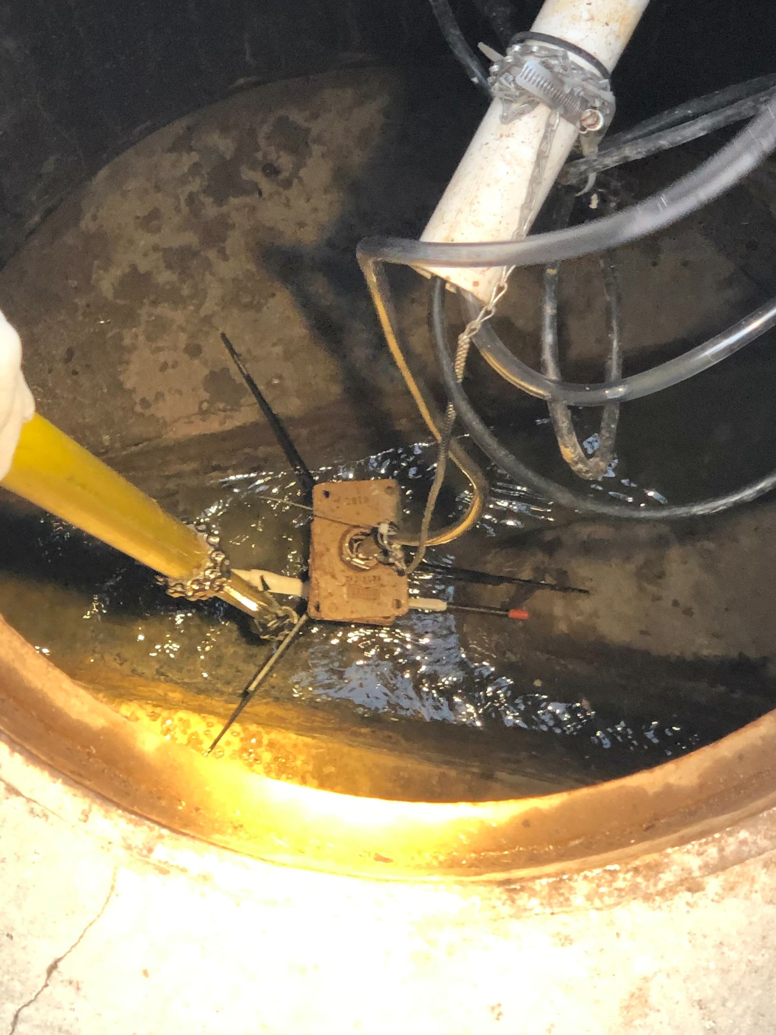

Slide 26
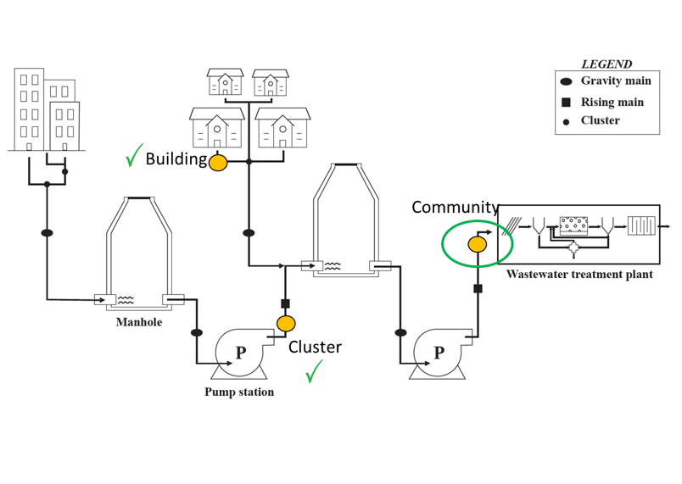
Watershed Scales
C,D
E,F
A,B

Slide 27
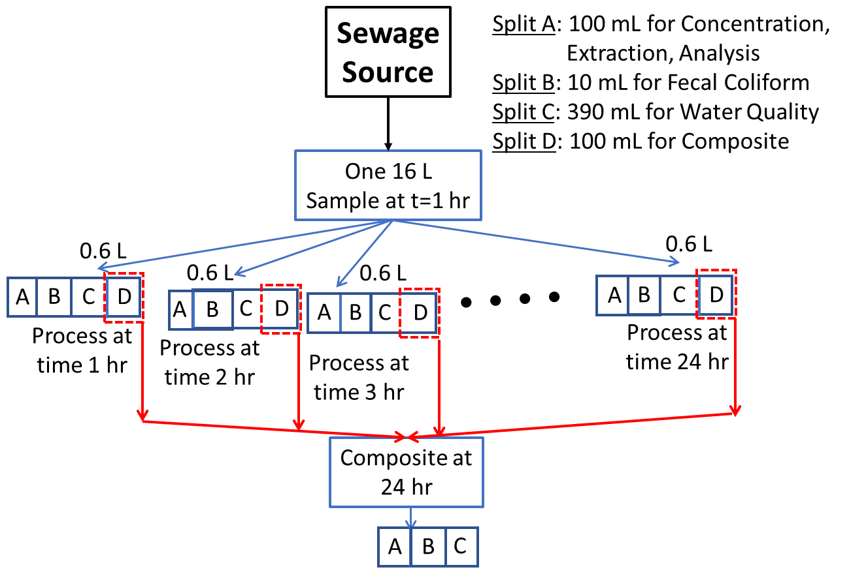
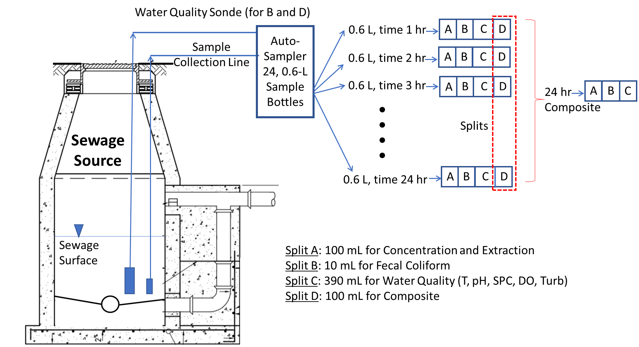
Experimental Design
Experiments
A, C, E
Experiments
B, D, F
Compare degradation of SARS-CoV-2
Hour-to-hour variability

Slide 28
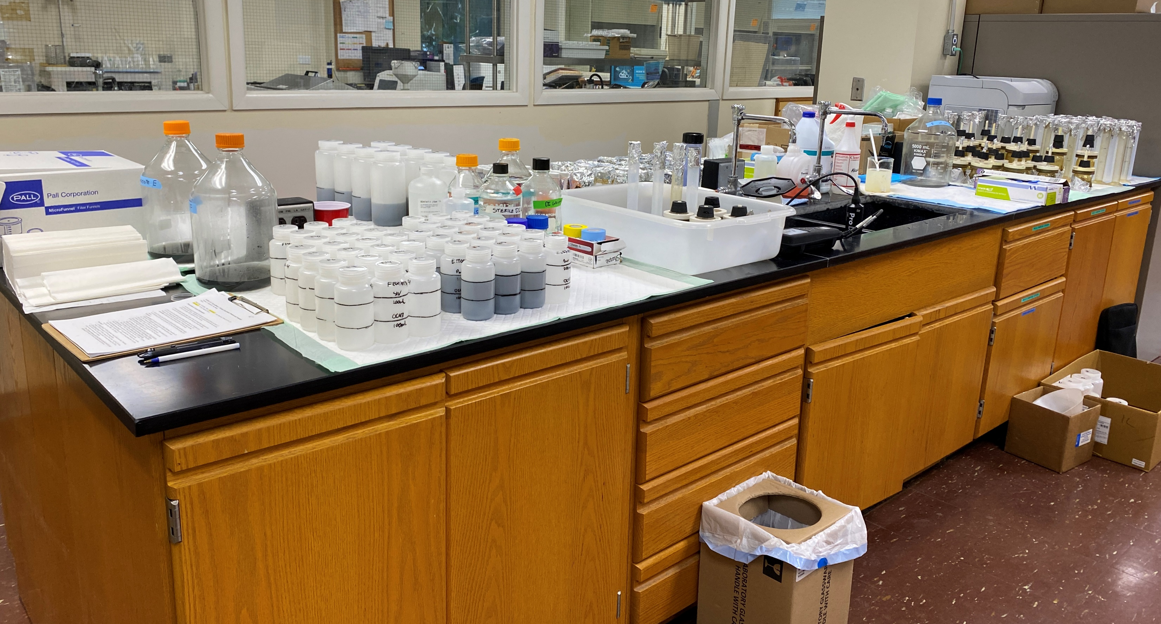

Slide 29
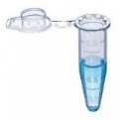





Sample Analysis Plan (Hourly Sampling)
Integrated Genomics Lab, Weill Cornell Medicine/MetaSub
Chris Mason
Sylvester Cancer Center OncoGenomics Shared Resource
Sion Williams
Electronegative Filtration
Center for AIDS Research
Mark Sharkey
OC43
& SIV
Acidify
(HCl)
MgCl₂
2 Filters in
3 mL DNA/RNA Shield
Extraction
250 mL
HIV Spike
Pure RNA
SARS-CoV-2
(NC gene)
SIV
V2G-qPCR
OC43
PMMoV
Continuous Flow and
continuous water quality
measurements
Water Quality
T, pH, SPC, DO, Turb
B2M
HIV
Extract
control
Fecal Coliform
Composite

Slide 30



SARS-CoV-2
C D: Building
A B: Cluster
3 logs
1.5 logs
E F: Community
1.5 logs

Slide 31
Conclusions
Wastewater in sewer variable.
  3 log-10 variation in SARS-CoV-2 observed at building scale
  1.5 log-10 variation in SARS-CoV-2 observed at cluster and community scale
Degradation at room temperature, secondary
Fecal coliform shows evidence of multiplication in sewer
Specific conductivity correlated with fecal coliform at building scale
Next Steps
Complete analysis of remaining targets including metagenomics
Run statistics

Slide 32
Aim 3:
Integration with Human Health Surveillance

Slide 33


Slide 34

Performance of ARTIC protocol on clinical and wastewater samples: good library efficiency to amplify SARS-CoV-2
Oncogenomics Shared Resource Lab
Sylvester Comprehensive Cancer Center
(Sion Williams)
Integrated Genomics Lab (Chris Mason)

Slide 35


Detection of SARS-CoV-2 Lineages in Wastewater
Viral copies/L
time
January
February
March
City of Miami
April
May
June
July
August
September
Coverage of reference
SARS-CoV-2 lineages in City wastewater mirror patient data
Even at low viral load lineages can be discerned
High diversity followed by Alpha, Gamma, Mu, then Delta
Delta detectable at -7 days before first sequenced case
Mutant allele (<10%)
Mutant allele (10%,
20%, etc.)
Mutant allele (100%)
No coverage of that site

Slide 36
Detection of SARS-CoV-2 Lineages in Wastewater
Viral copies/L
January
February
March
Peak Alpha 80%
City of Miami
April
May
21 days before delta
June
7 days before delta
July
~1% First Delta case
August
40% Delta, 10% Mu
September
100% Delta
SARS-CoV-2 lineages in City wastewater mirror patient data
Even at low viral load lineages can be discerned
High diversity followed by Alpha, Gamma, Mu, then Delta
Delta detectable at -7 days before first sequenced case

Slide 37
Detection of SARS-CoV-2 Lineages in Wastewater
Viral copies/L
January
February
March
City of Miami
April
May
June
July
August
September
March 16th
South Gables Campus
Building Cluster
Peaks on Gables Campus reflect the abundance of Alpha in the City and patients

Slide 38
Detection of SARS-CoV-2 Lineages in Wastewater
Viral copies/L
January
February
March
City of Miami
April
May
June
July
August
September
May 11th
South Gables Campus
Low level Gamma cluster on campus
Distinct from City lineage distribution

Slide 39
Detection of SARS-CoV-2 Lineages in Wastewater
Viral copies/L
January
February
March
City of Miami
April
May
June
July
August
September
July 20th
North Gables Campus
Building 12
Building 12, 072021, all students tested, all negative
Lineage matches abundant Delta strain

Slide 40
Detection of SARS-CoV-2 Lineages in Wastewater
Viral copies/L
January
February
March
City of Miami
April
May
June
July
August
September
August 3rd – September 7th
South Gables Campus
& Building Clusters
Delta predominant lineage on campus in alignment with City and patients

Slide 41

City
Samples

Slide 42
Action Items
Complete analysis of the changes in variant dominance in wastewater and patient populations
Analyze daily data to decrease uncertainty in case predictions
Evaluate normalization of SARS-CoV-2 using PMMoV, B2M, fecal coliform
Analyze hourly data to evaluate representativeness of grab versus composite samples
Evaluate magnetic bead concentration methods
Continue data standardization
Complete operational informatics infrastructure

Slide 43



Outreach
MetaSUB-Miami/RADx (metasub.org)
Ethics AMIA (American Medical Informatics Association)
Connect to CDC-NWSS/NIST
Web-site under development (covidsfrad.org)

Slide 44







Acknowledgments: (NIH RADx-rad 1U01DA053941)
Thank you
UM Leadership
President Frenk
Dr. Erin Kobetz
George Grills
Facilities, G/R
John Tallon
Georgia Norton
Norman Pasquier
Cecil Bowen
Orlando Escorcia
Trent Williams
Jose Iglesias
Lazaro Chavez
Selvon Villafana
Ethics
Ken Goodman
Administration
Maria Robertson
Xue (Sherry) Yin
Environ. Health Safety
Dr. Jennifer Laine
Brian Reding
Shane Gillooly
Vaughn Munro
Sampling Teams
Brian Reding
Tom Stone
Sam Comerford
Marleina Drane
Lab Concentration
Melinda Boone
Elena Cortizas
Shashana Fiedler
Kristina Babler
Lab Detection
Center for AIDS Res.
Dr. Mario Stevenson
Dr. Mark Sharkey
Jessica Salinas
Onco-Genomics Lab
Dr. Sion Williams
Yoslay. Cardentay
Benjamin Currall
Weill Cornell Lab
Dr. Chris Mason
David Danko
Krista Ryon
Jon Foox
Dan Butler
Facilities, Med.
Dr. W. Lamar
Ed Hengtgen
Rob Curtis
Joseph Vota
Leo Petrache
M. Kuindua
Yanelis Reyes
Medical Security
Ray Valdes
City Miami Police
Students
Johann Amirali
Gabriella Cosculluela
Erik Lamm
Danni Mackler
Matthew Roca
Collette Thomas
Tori Thomas
Shelja Kumar
Samantha Abelson
Julio Contreras
Wei Zhang
Human Health
Naresh Kumar
Alejandro Mantero
Natasha Solle
Cynthia Beaver
Bhavarth Shukla
Darryl Pronty
Sebastian Arenas
Data Standards
Stephan Schȕrer
Dusica Vidovic
Daniel Cooper
Chris Mader
Caty Chung
Nakul Datar
Julio Perez
Shreeharsha Ven.
Miami-Dade Water & Sewer Dept

